Slide 1


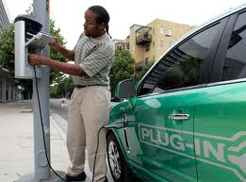
CA Solar Policy: Lessons and Pathways
Nicolas Chaset
Special Advisor for Distributed Energy Resources
Office of Governor Edmund G Brown

Slide 2
California’s Long-term Energy Vision
Transition California’s energy system to a highly efficient, renewables-based system and electrify transportation

Slide 3
Governor Brown’s Energy Policy Priorities
Cap and Trade
33% RPS
2020
12 GW of DG
1.5m ZEVs
2025
80% Below 1990 Emissions
2050

Slide 4
California: the real sunshine state?
-California has installed over 3,000 MWs solar
-Up to 12,000 MWs of solar by 2020

Slide 5
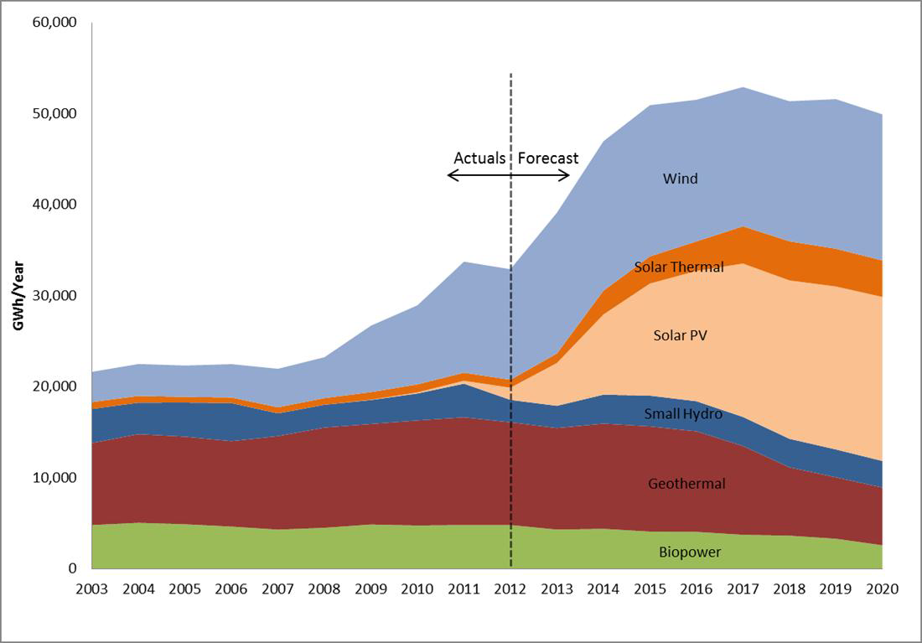
Wholesale Solar – large scale
-Solar PV fastest growing renewable resource
-Over 1,300 MWs installed to date
-Over 7,000 MWs expected by 2020

Slide 6
World’s 3 largest solar plants are located in California
Desert Topaz | CA Valley Solar Ranch | Desert Sunlight
Size: 550 MWs | Size: 250 MWs | Size: 250 MWs
Status: under construction | Status: On-line | Status: On-line
Cost: over $2b | Cost: over $1b | Cost: over $1b
Owner: MidAmerican Energy Holdings | Owner: NRG | Owner: NextEra

Slide 7
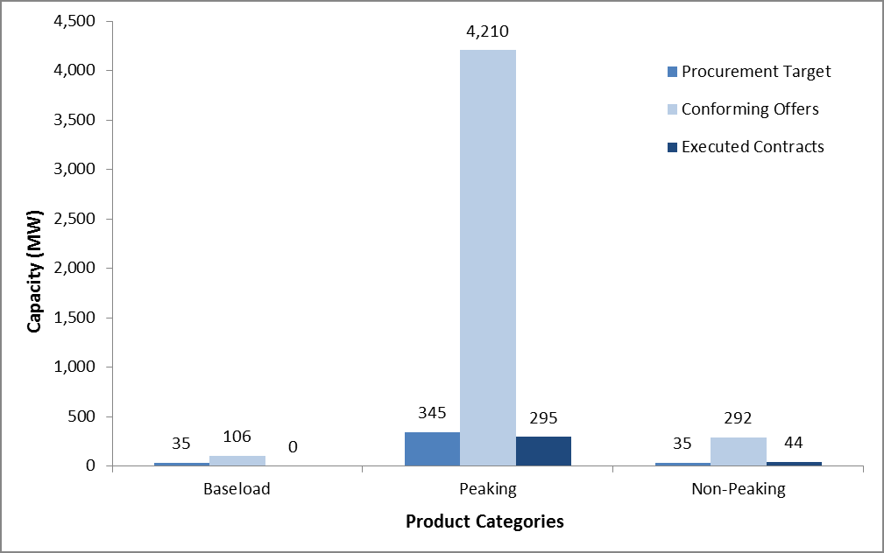
Wholesale DG Solar – RAM
Projects under 20 MWs 1250 MWs over 4 auctions
Results so far:
-very low prices
-extreme competition
-dominated by solar PV

Slide 8
Wholesale DG Solar – FiTs
Projects under 3 MWs 750 MWs over 24 months
Launched 10/13:
-bi-monthly price adjustment based on demand
-fixed MWs per 2 month period
$0.09/kWh
$0.095
$0.09
$0.085
$0.09
Start
+/- $0.005
+/- $0.005
$0.010
$0.08

Slide 9
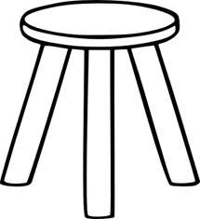
Three Pillars of CA ‘retail’ solar success
Transparent Interconnection
Rules
Certain, yet declining incentives (CSI)
Long-term Commitment to NEM

Slide 10
Net Energy Metering in CA
-1 MW size limit
-All REs eligible (99% solar)
-Full retail bill netting
-No special fees or charges can be applied
NEM Legislative History
1996 – 0.05% cap
2010 – 5% cap
2006 – 2.5% cap
2013 – 5 GW cap
2017 – cap lifted

Slide 11
California Solar Initiative
-Created in 2006 with 10 year expected life
-1,750 MW goal for CA IOUs
-$1b incentive decline by volume installed
-1,640 MWs installed/in construction

Slide 12
NEM Interconnection
Certainty
Rule 21 in place for over 10 years
Strict Timelines
Interconnection within 30 days by statute
Cost caps
Exempted from all fees and upgrade costs are capped
Success
+200,000 interconnections since 2007

Slide 13
AB 327: pathway to NEM 2.0
Adopt ‘fair’ NEM 2.0
Rate reform
Protect existing NEM customers
Study design options
Lift 1 MW Cap
Uncapped NEM

Slide 14
Developing NEM 2.0
Design Options
FiT, Value of Solar, Status Quo NEM
Understand Inputs
Rate designs
Design and Vet Tariff
Costs/Benefits
Parameters
No cost shift
All costs/benefits, including enviro/economic factors
Public input
Implement NEM 2.0
July 1, 2015
July 1, 2017

Slide 15
NEM 2.0 Expectations
NEM 1.0 or something close to it
Mandatory TOU + Grid Charge
Smart Inverter Requirements
Storage + Solar
+1 MW pay for grid upgrades

Slide 16
Plotting the Path for CAs Solar Future
NEM 2.0
Storage + Solar
Community Solar
Beyond 33% RPS

Slide 17
Thank You
Contact me:
Nicolas.chaset@cpuc.ca.gov

Slide 18
Energy Storage + Solar
-Up to 350 MWs
-Incentives + DR/AS market revenues opportunities
-Rate designs that incent
-Focus on SONGs replacement
-

Slide 19
Community Solar
-600 MW pilot
-Buckets for residential and larger customers
-Customers pay more, but fix rate
-Utility managed (at first)

Slide 20
Beyond 33% RPS
-RPS is a floor not ceiling
-1.5m EVs = 15 GWs of new peak
-SONGS replacement needs
-2050 GHG target drives more renewables

